Slide 1
The Nature of Teaching

Slide 2
The Nature of Teaching
Vocation
It is a calling.
It is innate.
It is something intrinsic.
Many people start, but only a few people see it through.

Slide 3
The Nature of Teaching
Mission
It is an elaborate task.
It is a big assignment.
It aims to promote social transformation.
It has a multiplier / ripple effect.

Slide 4
The Nature of Teaching
Profession
It is an occupation with salaries and attendant benefits for those in the formal sector.
It requires formal training and/or education.
Those who practice need a professional license.

Slide 5
Roles, Duties, and Responsibilities of the Teacher

Slide 6
The different roles of teachers
Lecturer
Planner
Facilitator
Assessor
Values formator
Record keeper
Materials developer

Slide 7
Lecturer
The lecturer function is the most common notion of a teacher—someone who provides knowledge.
A lecturer teaches the content. In this manner, the lecturer must follow a given syllabus and teach what is there in a manner that can be understood.

Slide 8
Facilitator
If you look at your lesson objectives, it says: “students will be able to,” not “teacher will be able to.”
Hence, the one who must do the work and learn is more of the learner than the teacher.

Slide 9
Facilitator
As a facilitator, you partly detach yourself so that they can work.
Do not breathe down on their necks as they work, but supervise from a safe distance.
If problems arise, be there to advise.

Slide 10
Facilitator
Effective facilitating is primarily based on whether the students are working on something meaningful or divergent, or not.
If the learners are all expected to arrive at just one answer, yes, you may facilitate, but it will be better if they discover different things.

Slide 11
Planner
A planner of lessons, teachers must combine what they know about the subject, the students, and the strategies in order to envision an effective lesson.
These plans are set into writing and, once checked by the coordinator, set into motion.

Slide 12
Assessor
As an assessor, a teacher must be guided by standards that will help him/her advise the learner about whether he/she is doing it right.
Not all assessments are judgments, though, since there are formative and summative assessments.

Slide 13
Values Formator
A teacher must be a “paragon of virtue.”
A teacher must try to adhere to the highest ethical and value standards as much as possible.
In short, a teacher must be the last person in whom students will see bad things.

Slide 14
Values Formator
A teacher, though, must help learners become better.
Teachers, do not be the first to condemn learners; instead, help them become better.

Slide 15
Record Keeper
As a classroom teacher and/or adviser, you need to keep students’ records, most especially their grades.
You also receive access to their contact information, normally provided through the Registrar’s and/or Guidance Office.

Slide 16
Materials Developer
Materials, whether visual, audio, or tactile, aid in the education of learners, and teachers must develop these materials in order to aid learning.
Of the many tasks of teachers, this can be among the most time-consuming, so teamwork among teachers handling the same subject can be considered.

Slide 17
Most common duties
Teach according to assignment
Enroll / help facilitate the enrollment of learners
Design / prepare effective lesson plans
Prepare visual aids and other materials
Help craft and implement classroom & school rules
Provide guidance services, on top of those provided by the guidance counselor

Slide 18
Most common duties
Assess and monitor students’ progress
Design, implement, and supervise CURRICULAR, CO-CURRICULAR, and EXTRA-CURRICULAR activities
Prepare, update, and keep school forms, records, such as attendance, grades and anecdotal records
Provide feedback to parents/guardians about the learners

Slide 19
Most common duties
Maintain membership in professional organizations
Attend trainings and participate in faculty meetings
Work with other stakeholders for the holistic development of learners
Participate in socio-economic development projects
Safeguard school facilities and equipment
Perform other teaching-related duties

Slide 20
Characteristics of a Teacher

Slide 21
Teacher = Good Moral Character
Fully human
Loving person
Virtuous person
Morally mature person

Slide 22
Characteristics
Knowledgeable
Competent
Effective
Efficient
Honest
Fair
Creative
Committed
Compassionate
Morally upright

Slide 23
R.A. No.4670: THE MAGNA CARTA FOR PUBLIC SCHOOL TEACHERS

Slide 24
I. DECLARATION OF POLICY COVERAGE
Sec. 1. Declaration of Policy. It is hereby declared to be the policy of this Act to promote and improve the social and economic status of public school teachers, their living and working conditions, their terms of employment and career prospects in order that they may compare favorably with existing opportunities in other walks of life, attract and retain in the teaching profession more people with the proper qualifications, it being recognized that advance in education depends on the qualifications and ability of the teaching staff and that education is an essential factor in the economic growth of the nation as a productive investment of vital importance.
Sec. 2. Title Definition. This Act shall be known as the "Magna Carta for Public School Teachers" and shall apply to all public school teachers except those in the professorial staff of state colleges and universities. The term "teacher" shall mean all persons engaged in classroom teaching, in any level of instruction, on full-time basis, including guidance counselors, school librarians, industrial arts or vocational instructors, and all other persons performing supervisory and/or administrative functions in all schools, colleges and universities operated by the Government or its political subdivisions; but shall not include school nurses, school physicians, school dentists, and other school employees.

Slide 25
II. RECRUITMENT AND CAREER
Sec. 3. Recruitment and Qualification.
For teachers in the kindergarten and elementary grades, Bachelor's degree in Elementary Education (B.S.E.ED.);
For teachers of the secondary schools, Bachelor's degree in Education or its equivalent with a major and a minor; or a Bachelor's degree in Arts or Science with at least eighteen professional units in Education;
For teachers of secondary vocational and two years technical courses, Bachelor's degree in the field of specialization with at least eighteen professional units in education; and
For teachers of courses on the collegiate level, other than vocational, master's degree with a specific area of specialization;

Slide 26
Provided, further, That in the absence of applicants who possess the minimum educational qualifications as hereinabove provided, the school superintendent may appoint, under a temporary status, applicants who do not meet the minimum qualifications: Provided, further, That should teacher-applicants, whether they possess the minimum educational qualifications or not, be required to take competitive examinations, preference in making appointments shall be in the order of their respective ranks in said competitive examinations: And provided, finally, That the results of the examinations shall be made public and every applicant shall be furnished with his score and rank in said examinations.
Sec. 4. Probationary Period. When recruitment takes place after adequate training and professional preparation in any school recognized by the Government, no probationary period preceding regular appointment shall be imposed if the teacher possesses the appropriate civil service eligibility: Provided, however, That where, due to the exigencies of the service, it is necessary to employ as teacher a person who possesses the minimum educational qualifications herein above set forth but lacks the appropriate civil service eligibility, such person shall be appointed on a provisional status and shall undergo a period of probation for not less than one year from and after the date of his provisional appointment.

Slide 27
Sec. 5. Tenure of Office. Stability on employment and security of tenure shall be assured the teachers as provided under existing laws.
Subject to the provisions of Section three hereof, teachers appointed on a provisional status for lack of necessary civil service eligibility shall be extended permanent appointment for the position he is holding after having rendered at least ten years of continuous, efficient and faithful service in such position.
Sec. 6. Consent for Transfer Transportation Expenses. Except for cause and as herein otherwise provided, no teacher shall be transferred without his consent from one station to another.
Where the exigencies of the service require the transfer of a teacher from one station to another, such transfer may be effected by the school superintendent who shall previously notify the teacher concerned of the transfer and the reason or reasons therefore. If the teacher believes there is no justification for the transfer, he may appeal his case to the Director of Public Schools or the Director of Vocational Education, as the case may be. Pending his appeal and the decision thereon, his transfer shall be held in abeyance: Provided, however, That no transfers whatever shall be made three months before any local or national election.
Necessary transfer expenses of the teacher and his family shall be paid for by the Government if his transfer is finally approved.

Slide 28
Sec. 7. Code of Professional Conduct for Teachers. Within six months from the approval of this Act, the Secretary of Education shall formulate and prepare a Code of Professional Conduct for Public School Teachers. A copy of the Code shall be furnished each teacher: Provided, however, That where this is not possible by reason of inadequate fiscal resources of the Department of Education, at least three copies of the same Code shall be deposited with the office of the school principal or head teacher where they may be accessible for use by the teachers.
Sec. 8. Safeguards in Disciplinary Procedure. Every teacher shall enjoy equitable safeguards at each stage of any disciplinary procedure and shall have:
a. the right to be informed, in writing, of the charges;
b. the right to full access to the evidence in the case;
c. the right to defend himself and to be defended by a representative of his choice and/or by his organization, adequate time being given to the teacher for the preparation of his defense; and
d. the right to appeal to clearly designated authorities.
No publicity shall be given to any disciplinary action being taken against a teacher during the pendency of his case

Slide 29
Sec. 9. Administrative Charges. Administrative charges against a teacher shall be heard initially by a committee composed of the corresponding School Superintendent of the Division or a duly authorized representative who should at least have the rank of a division supervisor, where the teacher belongs, as chairman, a representative of the local or, in its absence, any existing provincial or national teacher's organization and a supervisor of the Division, the last two to be designated by the Director of Public Schools.
Sec. 10. No Discrimination.
Sec. 11. Married Teachers. Whenever possible, the proper authorities shall take all steps to enable married couples, both of whom are public school teachers, to be employed in the same locality.
Sec. 12. Academic Freedom. Teachers shall enjoy academic freedom in the discharge of their professional duties, particularly with regard to teaching and classroom methods.
III. HOURS OF WORK AND REMUNERATION
Sec. 13. Teaching Hours. Any teacher engaged in actual classroom instruction shall not be required to render more than six hours of actual

Slide 30
classroom teaching a day, which shall be so scheduled as to give him time for the preparation and correction of exercises and other work incidental to his normal teaching duties.
Sec. 14. Additional Compensation. Notwithstanding any provision of existing law to the contrary, co-curricula and out of school activities and any other activities outside of what is defined as normal duties of any teacher shall be paid an additional compensation of at least twenty-five per cent of his regular remuneration after the teacher has completed at least six hours of actual classroom teaching a day.
Sec. 15. Criteria for Salaries. Teacher's salaries shall correspond to the following criteria:
(a) they shall compare favorably with those paid in other occupations requiring equivalent or similar qualifications, training and abilities;
(b) they shall be such as to insure teachers a reasonable standard of life for themselves and their families; and
(c) they shall be properly graded so as to recognize the fact that certain positions require higher qualifications and greater responsibility than others:
Sec. 16. Salary Scale. Salary scales of teachers shall provide for a gradual progression from a minimum to a maximum salary by means of regular increments, granted automatically after three years: Provided, That the efficiency rating of the teacher concerned is at least satisfactory. The progression from the minimum to the maximum of the salary scale shall not extend over a period of ten years.

Slide 31
Sec. 17. Equality in Salary Scales. The salary scales of teachers whose salaries are appropriated by a city, municipal, municipal district, or provincial government, shall not be less than those provided for teachers of the National Government.
Sec. 18. Cost of Living Allowance. Teacher's salaries shall, at the very least, keep pace with the rise in the cost of living by the payment of a cost-of-living allowance which shall automatically follow changes in a cost-of-living index.
Sec. 19. Special Hardship Allowances. In areas in which teachers are exposed to hardship such as difficulty in commuting to the place of work or other hazards peculiar to the place of employment, as determined by the Secretary of Education, they shall be compensated special hardship allowances equivalent to at least twenty-five per cent of their monthly salary.
Sec. 20. Salaries to be Paid in Legal Tender. Salaries of teachers shall be paid in legal tender of the Philippines or its equivalent in checks or treasury warrants.
Sec. 21. Deductions Prohibited. No person shall make any deduction whatsoever from the salaries of teachers except under specific authority of law authorizing such deductions.

Slide 32
IV. HEALTH MEASURES AND INJURY BENEFITS
Sec. 22. Medical Examination and Treatment. Compulsory medical examination shall be provided free of charge for all teachers before they take up teaching, and shall be repeated not less than once a year during the teacher's professional life. Where medical examination show that medical treatment and/or hospitalization is necessary, same shall be provided free by the government entity paying the salary of the teachers.
Sec. 23. Compensation For Injuries. Teachers shall be protected against the consequences of employment injuries in accordance with existing laws.
V. LEAVE AND RETIREMENT BENEFITS
Sec. 24. Study Leave. In addition to the leave privileges now enjoyed by teachers in the public schools, they shall be entitled to study leave not exceeding one school year after seven years of service. Such leave shall be granted in accordance with a schedule set by the Department of Education. During the period of such leave, the teachers shall be entitled to at least sixty per cent of their monthly salary.
Sec. 25. Indefinite Leave. An indefinite sick leave of absence shall be granted to teachers when the nature of the illness demands a long treatment that will exceed one year at the least.

Slide 33
Sec. 26. Salary Increase upon Retirement. Public school teachers having fulfilled the age and service requirements of the applicable retirement laws shall be given one range salary raise upon retirement, which shall be the basis of the computation of the lump sum of the retirement pay and the monthly benefits thereafter.
VI. TEACHER'S ORGANIZATION
Sec. 27. Freedom to Organize. Public school teachers shall have the right to freely and without previous authorization both to establish and to join organizations of their choosing, whether local or national to further and defend their interests.
Sec. 28. Discrimination Against Teachers Prohibited. The rights established in the immediately preceding Section shall be exercised without any interference or coercion.
VII. ADMINISTRATION AND ENFORCEMENT
Sec. 30. Rules and Regulations. The Secretary of Education shall formulate and prepare the necessary rules and regulations to implement the provisions of this Act. Rules and regulations issued pursuant to this Section shall take effect thirty days after publication in a newspaper of general circulation and by such other means as the Secretary of Education deems reasonably sufficient to give interested parties general notice of such issuance.
Sec. 31. Budgetary Estimates. The Secretary of Education shall submit to Congress annually the necessary budgetary estimates to implement the provisions of the Act concerning the benefits herein granted to public school teachers under the employ of the National Government.

Slide 34
Sec. 32. Penal Provision. A person who shall willfully interfere with, restrain or coerce any teacher in the exercise of his rights guaranteed by this Act or who shall in any other manner commit any act to defeat any of the provisions of this Act shall, upon conviction, be punished by a fine of not less than one hundred pesos nor more than one thousand pesos, or by imprisonment, in the discretion of the court.
If the offender is a public official, the court shall order his dismissal from the Government service.
Sec. 33. Repealing Clause. All Acts or parts of Acts, executive orders and their implementing rules inconsistent with the provisions of this Act are hereby repealed, amended or modified accordingly.
Sec. 34. Separability Clause. If any provision of this Act is declared invalid, the remainder of this Act or any provisions not affected thereby shall remain in force and in effect.
Sec. 35. This Act shall take effect upon its approval.
Approved: June 18, 1966

Slide 35
TEDP

Slide 36
Teacher Education Development Program (TEDP)
Singular competency-based framework for teaching and teacher development
Guides all policies, reforms, and activities
Conceptualizes a teacher’s career path as a continuum that starts with the entry to a teacher education program and concludes when a teacher reaches retirement

Slide 37
TEDP
TEDP means Teacher Education and Development Program.
TEDP is the articulation of a singular competency-based framework for teaching and teacher development that would guide all policies, reforms, and activities related to teaching and teacher development.
TEDP conceptualizes a teacher’s career path as a continuum that starts with the entry to a teacher education program and concludes when a teacher reaches retirement from formal service

Slide 38
TEDP
Agencies working hand in hand for the good of the teaching profession are Department of Education (DepEd), Commission on Higher Education (CHED), Professional Regulation Commission (PRC), Civil Service Commission (CSC) and Teacher Education Institutions (TEIs).

Slide 39
TEDP
The National Competency-Based Teacher Standards (NCBTS) is at the heart of the TEDP. It is the key element of the TEDP (Teacher Education and Development Program).

Slide 40
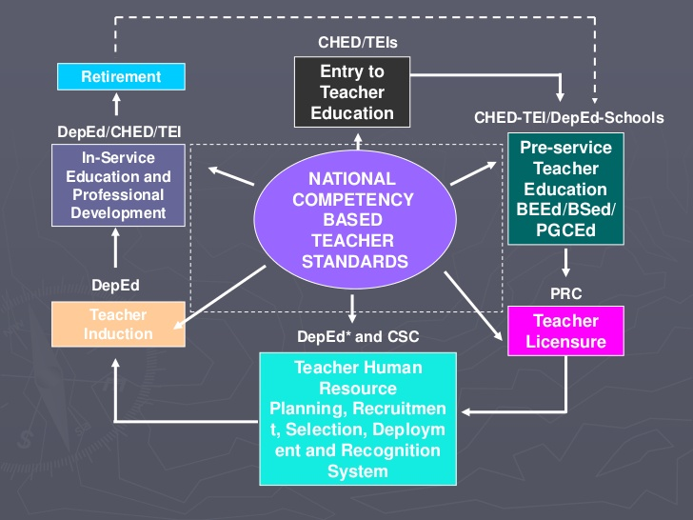
TEDP FRAMEWORK

Slide 41
How do you develop teachers?
START of IN-SERVICE: Induction Program
The induction program is an elaborate orientation activity for newly hired faculty members, whether fresh graduates or experienced.
School policies, requirements, “tips for survival,” and other information are shared here.

Slide 42
How do you develop your teachers?
START of EVERY YEAR: In-Service Training
Every year (normally a few weeks before the start of the next school/academic year), the administration organizes the mandated In-Service Training (INSET).
Depending on the school, this can last for three days to a week, or more, with various lectures/workshops provided for the faculty.

Slide 43
How do you develop your teachers?
BEFORE, DURING, and AFTER the year:
Faculty development seminars
Schools, or their partners like publishing houses, send teachers to seminars about the most recent trends in education.
If schools are also affiliated to national/international organizations, they also send representatives to the annual conventions.

Slide 44
How do you develop your teachers?
DURING the CAREER: Membership in professional organizations
If teachers become members of professional organizations, they get updated with the latest trends in their field, mainly through conferences and seminars, and sometimes through the research journal and other activities/publications.

Slide 45
Professional Development
After earning your bachelor’s degree and professional license, you need to pursue higher degrees: Master’s and Doctorate.
You likewise need to remain updated with what’s happening in the field, so join professional organizations and also participate in seminars and workshops.

Slide 46
NCBTS

Slide 47
The NCBTS
Harmonizes what it means to be an effective teacher
Defines what the Philippines looks for when a professional practices in the field of teaching
Aims to reduce variability in terms of “what is good,” especially useful when appraising performance

Slide 48
NCBTS
NCBTS means National Competency-Based Teacher Standards.
NCBTS defines effective teaching as being able to help all types of students learn the different learning goals in the
curriculum.
An integrated theoretical framework that defines the different dimensions of effective teaching.
According to the Framework, this will allow teachers to self-assess their own performance against the Competency Standards in order to identify areas of strength as well as areas that need to be developed further in order for them to function more effectively as facilitators of learning.
It is based on the core values of Filipino teachers
and on effective teaching and learning with seven (7)
domains, 23 strands and 80 performance indicators.

Slide 49
The NCBTS
Defines effective teaching as being able to help students achieve learning goals in the curriculum while recognizing their diversity
Integrated theoretical framework that defines the different dimensions of effective teaching
Allows teachers to self-assess their own performance against the standards to identify strengths and weaknesses

Slide 50
The NCBTS
Based on the core values of Filipino teachers
Based on indicators of effective teaching and learning
Has seven (7) domains, twenty-three (23) strands, and eighty (80) performance indicators

Slide 51
WHY DO WE NEED NCBTS?
Filipino teachers often got mixed signals about what it means to be an effective teacher. What may have been taught definitions of good teaching in their pre-service education seem to be different from what their principals and supervisors expect them in their schools or teachers are taught new teaching approaches that seem inconsistent with the Performance Appraisal System.
The NCBTS provides a single framework that shall define effective teaching in all aspects of a teacher's professional life and in all phases of teacher development. The use of a single framework should minimize confusion about what effective teaching is. The single framework should also provide a better guide for all teacher development programs and projects from the school level up to the national level.

Slide 52
WHO SHOULD USE THE NCBTS?
Teacher education institutions shall use the NCBTS to design and implement effective pre-service teacher education curricula.
The PRC shall refer the NCBTS in designing the Licensure Exam for Teachers.
Organizations and agencies that implement in-service education for teachers (INSET) shall refer to the NCBTS in developing their interventions.
Award-giving bodies shall refer to the NCBTS in defining their criteria for outstanding teachers.

Slide 53
WHO SHOULD USE THE NCBTS?
The DepED shall use this in formulating its hiring, promotion, supervision, and other policies related to the teaching profession.
It shall use the NCBTS to guide its INSET programs for teachers.
Most of all, individual teachers in all public and private elementary and high schools shall use it for their professional development activities.

Slide 54
How Should Teachers Use the NCBTS?
Teachers can use the NCBTS in many ways:
As a guide on their current teaching practices
As a framework for creating new teaching practices
As a guidepost for planning and professional development goals
As a common language for discussing teaching practices with other teachers

Slide 55
Domain 1: Social Regard for Learning
Key Question for the Teacher:
“Can my students appreciate and model the value of learning through my interactions with them?”
Explanation:
The domain of Social Regard for Learning focuses on the ideal that teachers serve as positive & powerful role models of the values of the pursuit of learning & of the effort to learn, & that the teachers actions, statements, & different types of social interactions with students exemplify this ideal.

Slide 56
Domain 2: Learning Environment
Key Question for the Teacher:
“Do I create a physical and social
environment in class that allows my
students to attain maximum learning?”
Explanation:
The domain of Learning Environment focuses on importance of providing for a social and physical environment within which all students, regardless of their individual differences in learning, can engage the different learning activities and work towards attaining high standards of learning.

Slide 57
Domain 3: Diversity of Learners
Key Question for the Teacher:
“Can I help my students learn whatever their capabilities, learning styles, cultural heritage, socio-economic backgrounds, and other differences are?”
Explanation:
The domain of Diversity of Learners emphasizes the ideal that teachers can facilitate the learning process in diverse types of learners, by first recognizing and respecting individual differences, then using knowledge about students’ differences to design diverse sets of learning activities to ensure that all students can attain appropriate learning goals.

Slide 58
Domain 4: Curriculum
Key Question for the Teacher:
“Can my students understand and attain the goals of the curriculum through the various learning resources and activities I prepared? Have I made use of ICT
appropriately”
Explanation:
The domain of Curriculum refers to all elements of the teaching-learning process that work in convergence to help students attain high standards of learning and understanding of the curricular goals and objectives. These elements include the teacher’s knowledge of subject matter, teaching-learning approaches and activities, instructional materials and learning
resources including ICT.

Slide 59
Domain 5: Planning, Assessing and Reporting
Key Question for the Teacher:
“Do I assess my students’ learning and knowledge using appropriate educational assessment procedures, and do I use the information from these assessment procedures in planning my teaching-learning activities for the students?”
Explanation:
The domain of Planning, Assessing & Reporting refers to the aligned use of assessment and planning activities to ensure that the teaching-learning activities are maximally appropriate to the students’ current knowledge and learning levels. In particular, the domain focuses on the use of assessment data to plan & revise teaching-learning plans, as well as the integration of formative assessment procedures in the plan and implementation of teaching-learning activities.

Slide 60
Domain 6: Community Linkages
Key Question for the Teacher:
“Are the goals and characteristics of the teaching-learning activities I implement relevant to the experiences, values and aspirations in my students’ communities?”
Explanation:
The domain of Community Linkages focuses on the ideal that school activities are meaningfully linked to the experiences and aspirations of the students in their homes and communities. Thus, the domain focuses on teachers’ efforts directed at strengthening the links between school and community activities as these help in the attainment of the curricular objectives.

Slide 61
Domain 7: Personal Growth and Professional Development
Key Question for the Teacher:
“Do my actions and statements indicate a high regard for the teaching profession and for my continuous development as a professional teacher?”
Explanation:
The domain of Personal Growth and Professional Development emphasizes the ideal that teachers value having a high personal regard, concern for professional development, and continuous improvement as teachers.

Slide 62
Users of NCBTS
Teacher education institutions (TEIs): to craft effective and aligned pre-service education curricula
Professional Regulation Commission (PRC): to align exams with the NCBTS
Providers of INSET and other training: to align interventions with the standards of NCBTS

Slide 63
Users of NCBTS
Award-giving bodies: refer to NCBTS for criteria of effective teaching
Department of Education: use it to craft standards for hiring, promotion, supervision, and other policies
Classroom teachers: use it for their profession development

Slide 64
What is an Individual Plan for Professional Development (IPPD)?
An IPPD is a tool that serves as a guide for the professional’s continuous learning and development.
The IPPD is structured such that every professional regularly and individually prepares, implements, monitors and updates the plan.
It is based on the identified development needs revealed by the Training and Development Needs Assessment (TDNA) appropriate for the specific profession and is consistent with the priority development goals of the school, division and region.

Slide 65
What is the purpose of accomplishing an IPPD?
The IPPD is accomplished by the professionals, e.g. School Heads and Teachers, to enable them chart their goals and plan learning activities that enhance their competencies in order for them to work better for the improvement of their school and learners’ performance.
Developing a structured IPPD allows them to practice individual accountability for professional growth and shared responsibility for the entire organization’s development.

Slide 66
CB-PAST

Slide 67
CB-PAST
CB-PAST means COMPETENCY-BASED PERFORMANCE APPRAISAL SYSTEM FOR TEACHERS.
CB-PAST is a tool used to assess public school teacher’s performance in terms of instructional competence, school, home and community linkages and personal, social growth and professional characteristics.
CB-PAST is an appraisal system which addresses one of the mandates of the Department as embodied in the Republic Act 9155.

Slide 68
AREAS OF CB-PAST
I. INSTRUCTIONAL COMPTENCE
II. SCHOOL, HOME AND COMMUNITY LINKAGES
III. PERSONAL, SOCIAL GROWTH AND PROFESSIONAL CHARACTERISTICS

Slide 69
I. INSTRUCTIONAL COMPTENCE
A. Diversity of Learners
B. Curriculum Content and Pedagogy
C. Planning, Assessing and Reporting

Slide 70
II. SCHOOL, HOME AND COMMUNITY LINKAGES
A. LEARNING ENVIRONMENT
B. COMMUNITY LINKAGES

Slide 71
III. PERSONAL, SOCIAL GROWTH AND PROFESSIONAL CHARACTERISTICS
A. Social Regard for Learning
B. Personal, Social Growth and Professional Development

Slide 72
PERSONS INVOLVED IN THE USE OF CB-PAST
The Individual Teacher
The School Principal
The Supervisor
The Department Heads
The Schools Division Superintendent

Slide 73
RPMS
RPMS means Results-Based Performance Management System.
RPMS replaces the CB-PAST and take effect among the public schools in the Philippines since the S.Y. 2014-2015.
RPMS is a shared undertaking between the superior and the employee that allows an open discussion of job expectations, key result areas, objectives and how these align to overall departmental goals.
It provides a venue for agreement on standards of performance and behaviors which lead to personal and professional growth in the organization.

Slide 74
RPMS
RPMS uses a form called IPCR which serves as a tool to assess teacher’s performance in terms of four parts.
IPCR means Individual Performance Commitment and Review Form.
FOUR PARTS OF IPCR
PART 1.Accomplishements of KRAs and Objectives
PART 2.Competencies
PART 3.Summary of Ratings for Discussion
PART 4.Development Plans

Slide 75
RPMS
Scaling System
A score of 1 means poor.
A score of 2 means unsatisfactory.
A score of 3 means satisfactory.
A score of 4 means very satisfactory.
A score of 5 means outstanding.

Slide 76
Professional Organizations for Teachers

Slide 77
Professional Organizations
Professional organizations are either local or international groups devoted to help the officers and members improve.
Some have research publications, while others provide seminars and training, and also organize conferences.

Slide 78
Professional Organizations
Do not just be limited to organizations devoted in general to education or teaching.
Be a member of specialized associations or organizations.

Slide 79
Foundations
Foundations are often charitable organizations bound to support a given cause.
Among the most famous foundations related to teachers is the Metrobank Foundation, which confers the “Metrobank Outstanding Teacher Award.” There are ten (10) awardees per year, and they get at least P400,000 each.

Slide 80
Components of Effective Teaching

Slide 81
Components of Effective Teaching
Analytic/Synthetic Approach
Discusses points of view other than his/her own
Contrasts implications of various theories
Discusses recent developments in the field
Presents origins of ideas and concepts
Gives references for more interesting and involved points
Presents facts and concepts from related fields
Emphasizes conceptual understanding
Organization/Clarity
Explains clearly
Is well prepared
Gives lectures that are easy to outline
Is careful and precise in answering questions
Summarizes major points
States objectives for each class session
Identifies what he/she considers important

Slide 82
Components of Effective Teaching
Instructor-Group Interaction
Encourages class discussion
Invites students to share their knowledge and experiences
Clarifies thinking by identifying reasons for questions
Invites criticism of his/her own ideas
Knows if the class is understanding him/her or not
Has interest and concern in the quality of his/her teaching
Has students apply concepts to demonstrate understanding
Instructor--Individual Student Interaction
Has a genuine interest in students
Is friendly toward students
Relates to students as individuals
Recognizes and greets students out of class
Is accessible to students out of class
Is valued for advice not directly related to the course
Respects students as persons

Slide 83
Components of Effective Teaching
Dynamism/Enthusiasm
Is a dynamic and energetic person
Has an interesting style of presentation
Seems to enjoy teaching
Is enthusiastic about the subject
Seems to have self-confidence
Varies the speed and tone of voice
Has a sense of humor

Slide 84
21st-Century Education

Slide 85
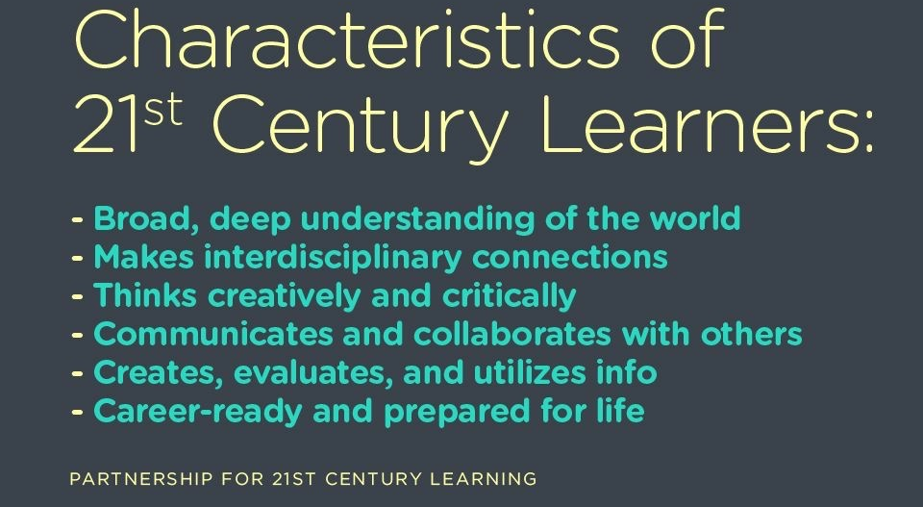
Characteristics of 21st-Century Learners

Slide 86
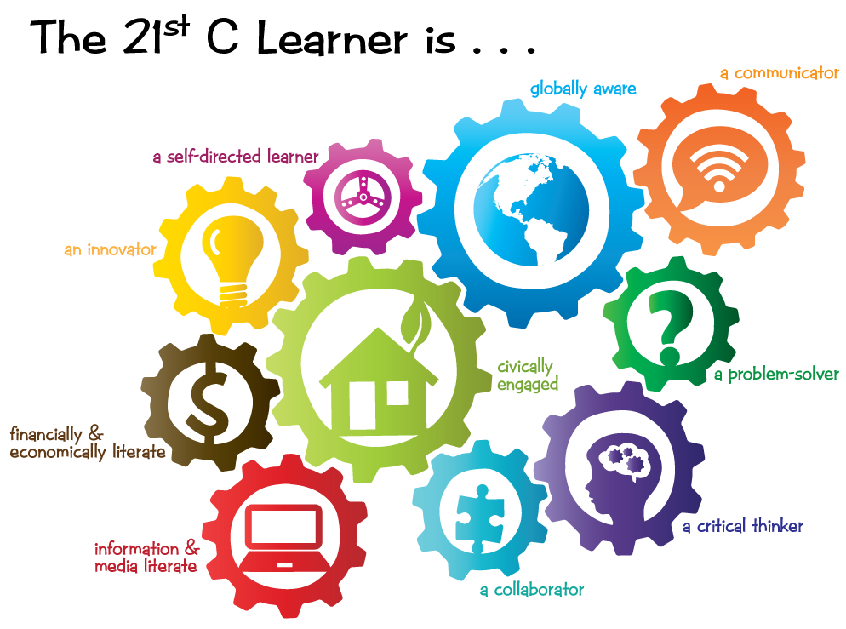
Who is the 21st-Century Learner?
Photo Credit: http://www.rockyview.ab.ca/home/21stC/learning/assets/images/gears/

Slide 87
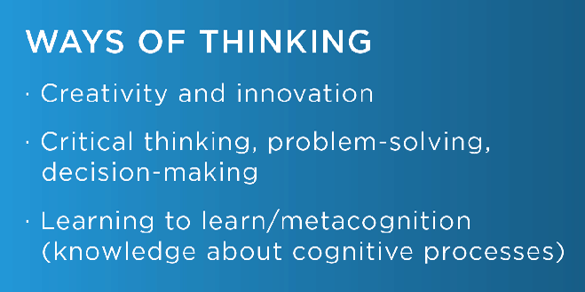
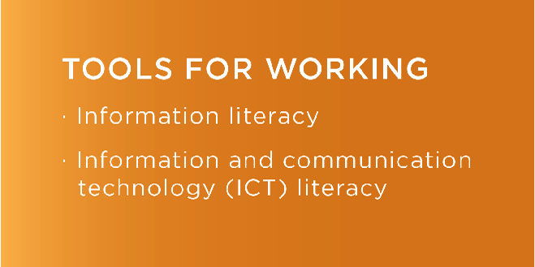


What are the categories?

Slide 88
ASEAN INTEGRATION

Slide 89
GLOBALIZATION AND EDUCATION

Slide 90
GLOBALIZATION ISSUES

Slide 91
LEGAL BASES OF EDUCATION

Slide 92
FOUR DIMENSIONS OF LEGAL BASES OF EDUCATION IN THE PHILIPPINES
1. The Philippines Constitution of 1987
Article XIV – Education Science and Technology, Arts, Culture and Sports
The State shall protect and promote the right of all citizens to quality education at all levels and shall take appropriate steps to make such education accessible to all
The State shall enhance the right of teachers to professional advancement
The State shall establish, maintain and support a complete, adequate and integrated system of education relevant to the needs of the people and society…

Slide 93
FOUR DIMENSIONS OF LEGAL BASES OF EDUCATION IN THE PHILIPPINES
2. Decree No. 6-A also known as Educational Development Decree of 1972
Aims to achieve national development goals (accelerating rate of economic development and progress, assure maximum participation of all people in attainment and enjoyment of the benefit of such growth, strengthen national consciousness and promote desirable cultural values in a changing world) through a good educational system

Slide 94
FOUR DIMENSIONS OF LEGAL BASES OF EDUCATION IN THE PHILIPPINES
OBJECTIVES of a good educational system :
1. Provision for a broad general education
Assists every individual to attain his potentials as human being, enhance the range and quality of individual and group participation in the basic functions of society, and acquire the essential educational foundation of his development into a productive and versatile citizen
2. Manpower training in middle-level skills
Required for national development
3. Development of the high-level profession
Provide leadership for nation in advancement of knowledge – improving quality of human life
4. Educational planning and evaluation
Respond to the needs and conditions of the nation

Slide 95
FOUR DIMENSIONS OF LEGAL BASES OF EDUCATION IN THE PHILIPPINES
Educational System :
1. FORMAL EDUCATION
refers to the hierarchically structured and chronologically graded learnings organized and provided by the formal school system and for which certification is required in order for the learner to progress through the grades or move to higher levels
Is the society’s primary learning system and therefore the main instrument for the achievement of the country’s educational goals and objectives

Slide 96
FOUR DIMENSIONS OF LEGAL BASES OF EDUCATION IN THE PHILIPPINES
COMPONENTS of FORMAL EDUCATION
1. Elementary Education – the first stage of compulsory, formal education primarily concerned with providing basic education and usually corresponding to 6 or 7 grades including pre-school programs
2. Secondary Education – the stage of formal education following the elementary level concerned primarily with continuing basic education and expanding it to include the learning of employable gainful skills, usually corresponding to four years of high school
3. Tertiary Education – post-secondary schooling is higher education leading to a degree in specific profession or discipline

Slide 97
FOUR DIMENSIONS OF LEGAL BASES OF EDUCATION IN THE PHILIPPINES
2. NON-FORMAL EDUCATION and SPECIALIZED EDUCATIONAL SERVICES
Goals :
To eradicate illiteracy and raise the level of functional literacy of the population,
To provide unemployed and underemployed youth and adults with appropriate vocational/technical skills to enable them to become more productive and effective citizens
To develop among clientele of non-formal education proper values and attitudes necessary for personal, community and national development

Slide 98
FOUR DIMENSIONS OF LEGAL BASES OF EDUCATION IN THE PHILIPPINES
COMPONENTS of NON-FORMAL EDUCATION
1. Work Education or Practical Arts – a program of basic education which aims to develop the right attitudes towards work; and ‘technical-vocational education’, post-secondary but non-degree programs leading to one-two, or three year certificates in preparation for a group of middle-level occupations
2. Special Education – the education who are physically, mentally, emotionally, socially or culturally different from the so called ‘normal’ individuals that they require modification of school practices/services to develop them to their maximum capacity

Slide 99
FOUR DIMENSIONS OF LEGAL BASES OF EDUCATION IN THE PHILIPPINES
COMPONENTS of NON-FORMAL EDUCATION
3. Non-Formal Education – any organization school-based educational activities undertaken by MECS and other agencies aimed at attaining specific learning objectives for a particular clientele, especially the illiterates and the out-of-school youth and adults, distinct from and outside the regular offerings of the formal school system

Slide 100
FOUR DIMENSIONS OF LEGAL BASES OF EDUCATION IN THE PHILIPPINES
4. The Educational Act of 1994 otherwise known as Republic Act No. 7722
An Act creating the Commission on Higher Education
The Commission shall be independent and separate from the DECS and attached to the Office of the President for administrative purposes only
Its coverage shall be both public and private institutions of higher education as well as degree-granting programs in all post-secondary educational institutions, public and private

Slide 101
OTHER EDUCATIONAL LAWS
Presidential Decree No. 1006 : Decree in Professionalizing Teaching
Providing for the Professionalization of Teachers, Regulating Their Practice In The Philippines And For Other Purposes
Republic Act No. 7836 : Philippine Teachers Professionalization Act of 1994
An Act which strengthens the regulation and supervision of the practice of teaching in the Philippines and prescribing a Licensure Examination for Teachers and other purposes
Republic Act No. 9293
An Act amending certain sections of RA 7836
Amended sections are Sec. 15, 26 and 31
The term DECS to DepEd

Slide 102
OTHER EDUCATIONAL LAWS
Republic Act No. 4670 : The Magna Carta for Public School Teachers
This Act promotes and improves the social and economic status of PUBLIC school teachers, their living and working conditions. Their employment and career prospects in order that they may compare favorably with existing opportunities in other walks of life, attract and retain in the teaching profession more people with the proper qualification
Republic Act No. 9155 : Government of Basic Education of 2001
An Act instituting the framework of governance for basic education, establishing authority and accountability, renaming the DECS as DepEd

Slide 103
OTHER EDUCATIONAL LAWS
Free Public Secondary Act of 1988
The act established and provided for a free public secondary education to all qualified citizens
Republic Act No. 7796: TESDA Act of 1994
The creation of Technical Education and Skills Development Authority.
Republic Act No. 8292 : Higher Education Modernization Act
The Act which provides the uniform composition and powers of the governing boards of stat universities and colleges (SUCs) with the chairman of CHED as the chair of the governing board of all SUCs

Slide 104
EDUCATIONAL DECREE OF 1863: The decree provided for the establishment of primary school for boys and girls in each town of the country. ACT NO. 74 OF 1901: Enacted into law by the Philippine Commission, the Act created the Department of Public Instruction, laid the foundations of the public school system in the Philippines, provided for the establishment of the Philippine Normal School in Manila and made English as the medium of instruction. (In 1949, the Philippine Normal School was made a teachers' college by virtue of RA 416 and, in 1991, it became a full-pledge university by virtue of RA 7168.) VOCATIONAL ACT OF1927: Also known as Act No. 3377, the Vocational Act as amended by other acts laid the foundations of vocational education in public schools and made provisions for its support. REORGANIZATION ACT OF 1947: The Act placed public and private schools under the supervision and control of the Bureau of Public and Private Schools.

Slide 105
REPUBLIC ACT 5250 OF 1966: The Act provided the legal basis for the implementation of a ten-year teacher education program in special education. DEPARTMENT OF EDUCATION, CULTURE AND SPORTS (DECS) ORDER NO. 25 OF 1974: Popularly known as the Bilingual Education Program of 1974, the Order required the use of English as medium of instruction for science and mathematics subjects and the use of Filipino as medium of instruction for all other subjects in the elementary and high school levels. PRESIDENTIAL DECREE NO. 1006 OF 1976: The Decree was a legal and formal recognition of teachers as professionals and teaching as a profession.
REPUBLIC ACT NO. 5698: The Act created the Legal Education Board whose task was to regulate and improve the quality of law schools in the Philippines in order to stop the increasing number of examinees who fail to pass the bar examinations given every year. REPUBLIC ACT 6655 OF 1988: Popularly known as the Free Public Secondary Education Act of 1988, the Act created a system of free education in public high schools.

Slide 106
BATAS PAMBANSA BLG. 232
=IS ALSO KNOWN AS EDUCATIONAL ACT OF 1982
=AN ACT PROVIDING FOR THE ESTABLISHMENT AND MAINTENANCE OF AN INTEGRATED SYSTEM OF EDUCATION
=Sec. 5.
Declaration of Policy and Objectives – The State shall:
1. Aid and support the natural right and duty of parents in the rearing of the youth through the educational system.
2. Promote and safeguard the welfare and interest of the students by defining their rights and obligations, according them privileges, and encouraging the establishment of sound relationships between them and the other members of the school community.
3. Promote the social economic status of all school personnel, uphold their rights, define their obligations, and improve their living and working conditions and career prospects.
4. Extend support to promote the viability of those institutions through which parents, students and school personnel seek to attain their educational goals.

Slide 107
DEPARTMENT OF EDUCATION, CULTURE AND SPORTS (DECS) ORDER NO. 1 OF 1994: This Order increased the number of school days to 200 days (42 calendar weeks) inclusive of examination days for public and private schools. (This department order is similar to RA 7791 which increased the number of school days from 185 to 200 days.
REPUBLIC ACT NO. 7836 OF 1994: Known as the Philippine Teachers Professionalization Act of 1994, the Act made it mandatory for people pursuing a career in teaching to take the licensure examinations that are administered and regulated by the Professional Regulatory Commission.

Slide 108
Republic Act No. 9293 during the year 1994
=AN ACT AMENDING CERTAIN SECTIONS OF REPUBLIC ACT NUMBERED SEVENTY-EIGHT HUNDRED AND THIRTY-SIX (R. A. NO. 7836), OTHERWISE KNOWN AS THE "PHILIPPINE TEACHERS PROFESSIONALIZATION ACT OF 1994“
REPUBLIC ACT NO. 9155 on August 11, 2001
=AN ACT INSTITUTING A FRAME WORK OF GOVERNANCE FOR BASIC EDUCATION, ESTABLISHING AUTHORITY AND ACCOUNTABILITY, RENAMING THE DEPARTMENT OF EDUCATION, CULTURE AND SPORTS AS THE DEPARTMENT OF EDUCATION, AND FOR OTHER PURPOSE
REPUBLIC ACT NO. 10157 of 2012
=AN ACT INSTITUTIONALIZING THE KINDERGARTEN EDUCATION INTO THE BASIC EDUCATION SYSTEM AND APPROPRIATING FUNDS THEREFORE.

Slide 109
Republic Act No. 10533
=The Enhanced Basic Education Act of 2013
=also known as the K-to-12 Act
=“An Act Enhancing the Philippine Basic Education System by Strengthening Its Curriculum and Increasing the Number of Years for Basic Education, Appropriating Funds Therefore and for Other Purposes

Slide 110
SELECTED DEPED PROGRAMS AND PROJECTS

Slide 111
MTB-MLE
K-12 Program
Equivalency Program
ALS
Brigada Eskwela

